Slide 1



PEILab Group Meeting
Leader: Zicong Hong
Team Member: Jian Lin, Haodong Wang, Qianli Liu, Kaibin Guo, Junjie Liu

Slide 2
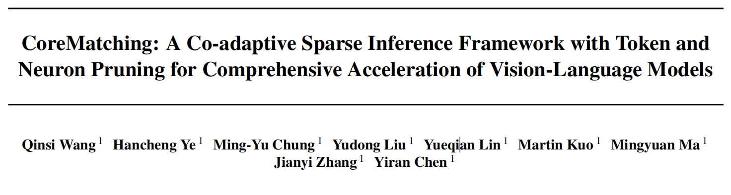
CoreMatching
ICML’25

Slide 3
CoreMatching
Token Sparsity Neuron Sparsity

Slide 4
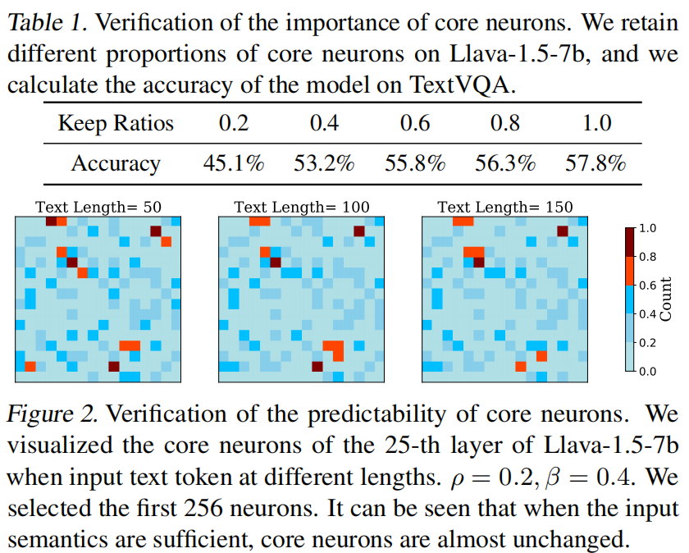
CoreMatching
First, they are crucial for the in_x0002_ference, as only core neurons retained can maintain the
performance. Second, they exhibit predictability; when
input is sufficiently long and semantically rich, the core
neurons identified during the pre-filling stage closely align
with those in the decoding stage.

Slide 5
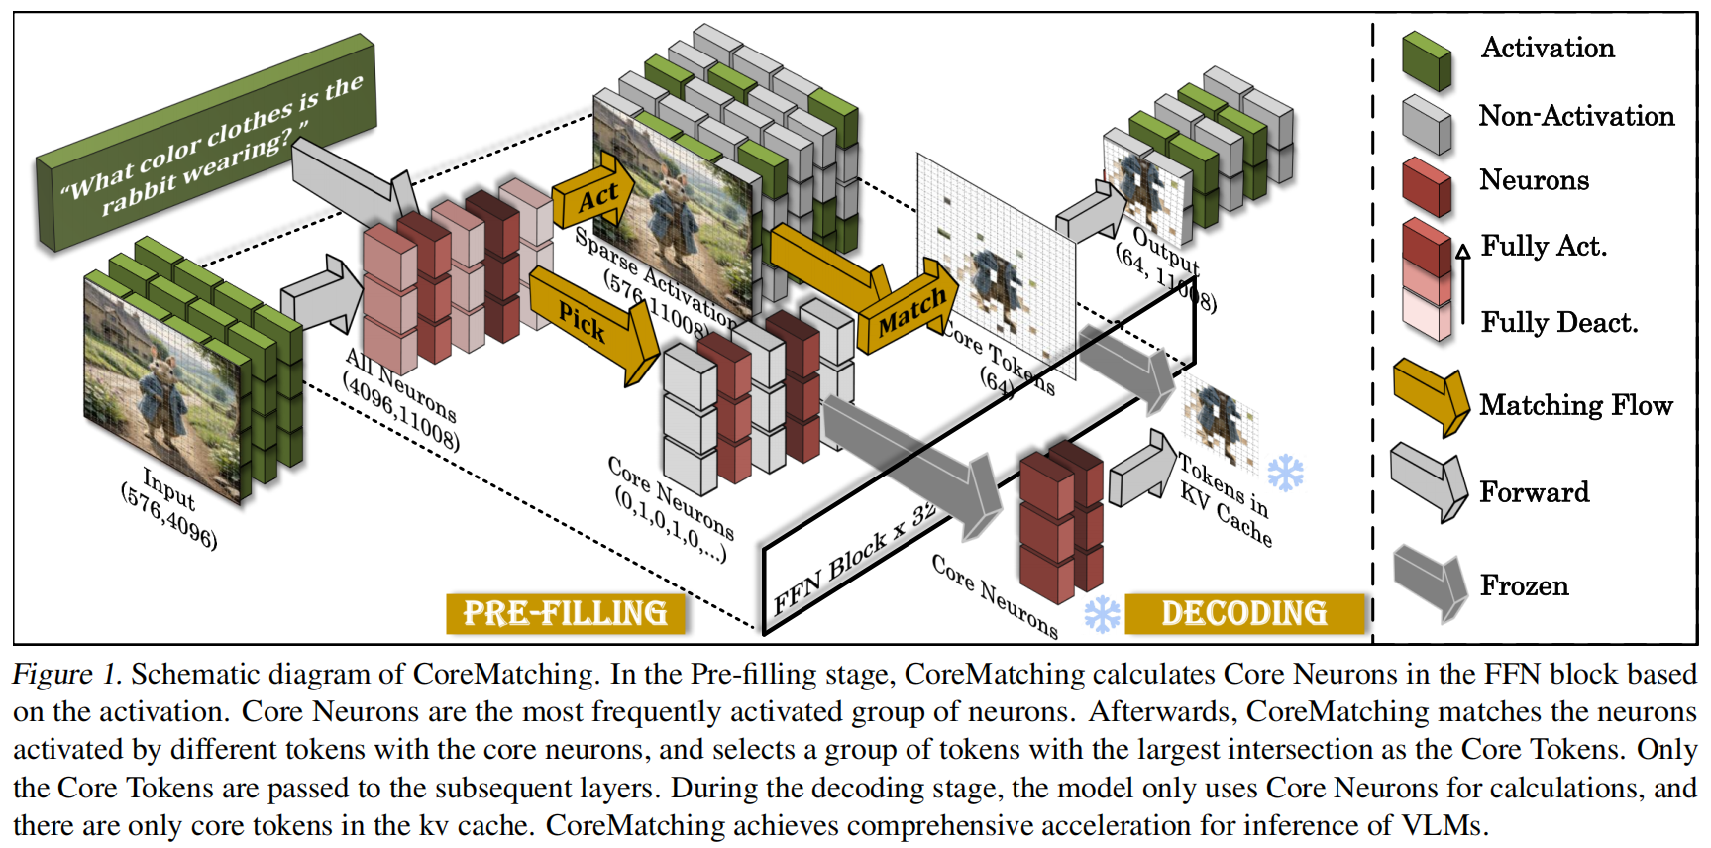
CoreMatching

Slide 6
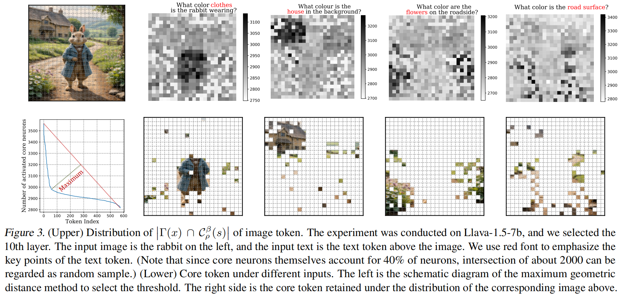
CoreMatching
The subset of
tokens that activate the largest number of core neurons
are the most critical for the inference.

Slide 7
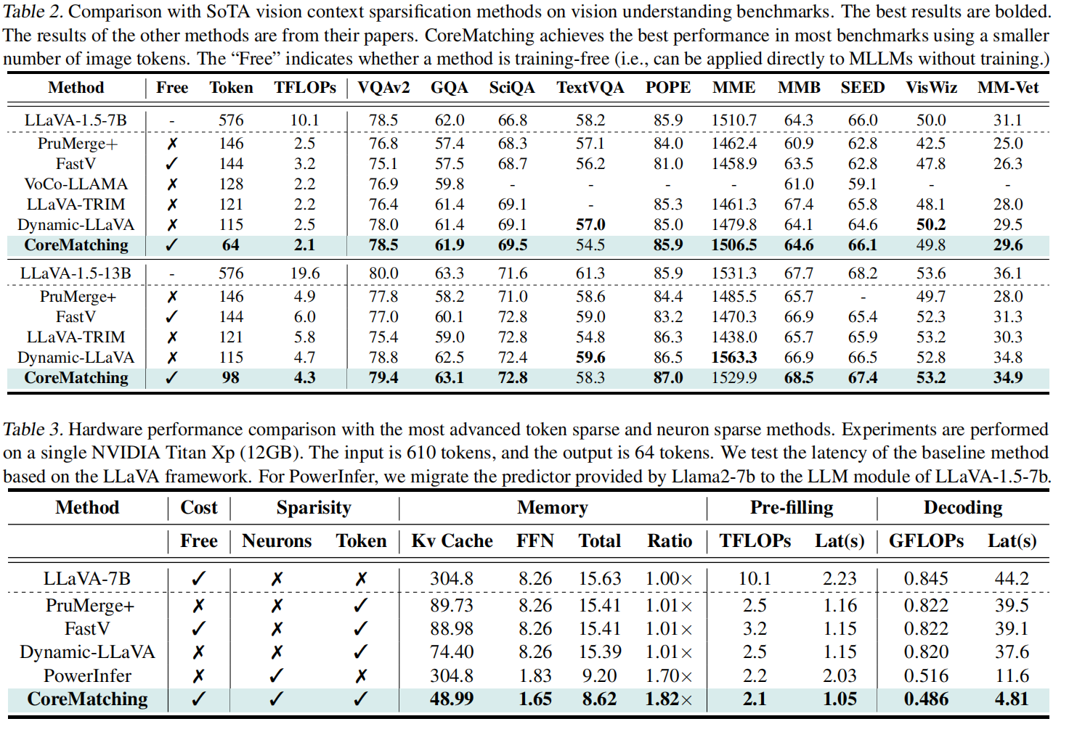
CoreMatching

